Slide 1


Deep Learning

Slide 2

Overview
Introduction to Deep Learning
Traditional vs Deep Learning
When does Deep Learning outperform Traditional Approaches?
Deep Learning Concepts
Deep Learning and Computer Vision

Slide 3
Introduction to Deep Learning

Slide 4
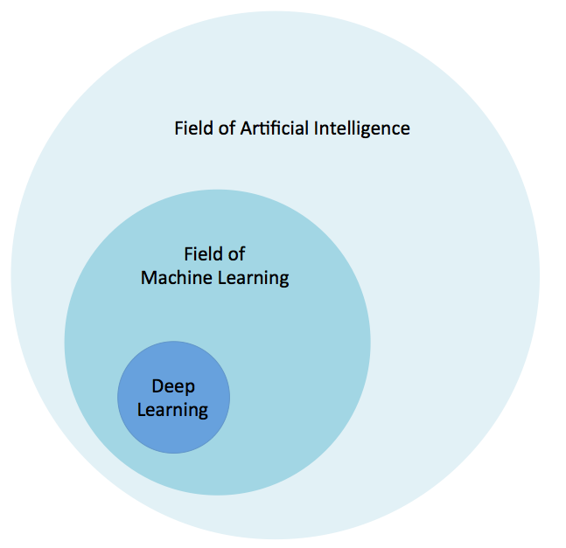
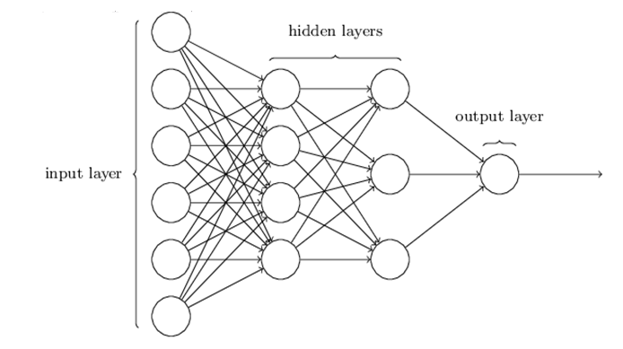
What Is Deep Learning?
Based on Algorithms that attempt to model high level abstractions in data
Deep learning is synonymous with artificial neural network (ANN)
“deep” -> depth of the network

Slide 5
Why Is Deep Learning Popular?
DL models has been around for a long time
Fukushima (1980) – Neo-Cognitron
LeCun (1989) – Convolutional Neural Network
DL popularity grew recently
With growth of Big Data
With the advent of powerful GPUs

Slide 6
Motivation: Why Go Deep
Deep Architectures can be representationally efficient
Fewer computational units for same function
Deep Representations might allow for a hierarchy or representation
Allows non-local generalization
Comprehensibility
Multiple levels of latent variables allow combinatorial sharing of statistical strength
Deep architectures work well (vision, audio, NLP, etc.)

Slide 7
Different Levels Of Abstraction
Hierarchical Learning
Natural progression from low level to high level structure as seen in natural complexity
Easier to monitor what is being learnt and to guide the machine to better subspaces
A good lower level representation can be used for many distinct tasks

Slide 8
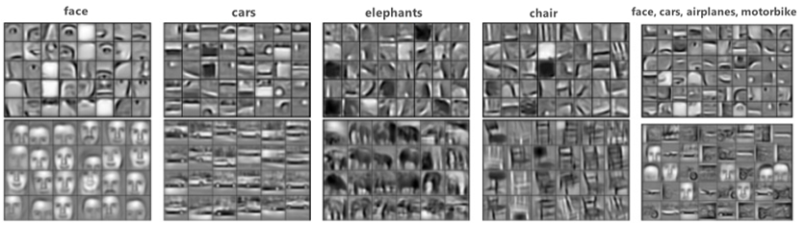
Compositional Data
Natural Data is Compositional
A combination of simple forms and complex forms
For example, a face is composed of two eyes, a nose and a mouth

Slide 9
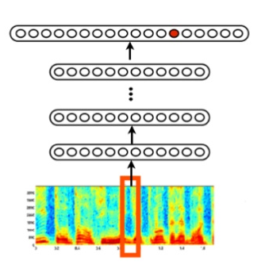
Compositional Data
Sound

Slide 10
Traditional vs Deep Learning

Slide 11
Traditional Approach
Feature extractors, required:
Expert knowledge
Time-consuming hand-tuning
In industrial applications, this 90% of the time
Sometimes are problem specific
But, what if we could learn feature extractors ?

Slide 12
Traditional Approach vs Deep Learning
Traditional ML requires manual feature extraction/engineering
Feature extraction for unstructured data is very difficult
Deep learning can automatically learn features in data​
Deep learning is largely a "black box" technique, updating learned weights at each layer

Slide 13
When does Deep Learning work better than Traditional Approaches?

Slide 14
Start Simple
Start with the simplest hypothesis space first:
i.e., try a linear model such as logistic regression.
If this doesn't work “well” (in other words, it doesn't meet our performance expectation – accuracy/precision/recall,etc.), move on to the next experiment.
The next experiment could be a “worry-free” approach if it exists in ML ☺

Slide 15
“Worry-Free” Approach
Random forests are probably THE "worry-free" approach
No real hyperparameters to tune (except for the number of trees)
Lot of knobs to be turned in SVMs: Choosing the “right” kernel, regularization penalties, etc
Random forests / SVMs:
The complexity grows as the number of training samples increases
More trees means more expensive to build a random forest. Also, we can end up with a lot of support vectors in SVMs.
Although, there are multi-class SVMs, the typical implementation for mult-class classification is One-vs.-All. In contrast, decision trees or random forests can handle multiple classes out of the box.

Slide 16
Rule of Thumb
SVMs are great for relatively small data sets with few outliers.
Random forests may require more data but they almost always come up with a pretty robust model.
Deep learning algorithms:
Cons:
Require "relatively" large datasets to work well. In addition, we need the infrastructure to train them in reasonable time. Setting up a neural networks is much more tedious than using an off-the-shelf classifiers such as random forests and SVMs.
Pros:
Deep learning really shines when it comes to complex problems such as image classification, natural language processing, and speech recognition.
Very less effort with Feature Engineering

Slide 17
Summary
In practice, the decision which classifier to choose depends on:
your dataset.
general complexity of the problem -- that's where your experience as machine learning practitioner kicks in.
Define a performance metric to evaluate your model
Ask yourself: What performance score is desired, what hardware is required, what is the project deadline.
Start with the simplest model
If you don't meet your expected goal, try more complex models (if possible)

Slide 18
Deep Learning Concepts

Slide 19
Deep Learning Begins With A Little Function
It all starts with a humble linear function called a perceptron
weight1 × input1
weight2 × input2
weight3 × input3
sum
Perceptron:
If sum > threshold: output 1
Else: output 0
✚
Example: The inputs can be your data. Question: Should I buy this car?
0.2 × gas mileage
0.3 × horsepower
0.5 × num cup holders
sum
Perceptron:
If sum < threshold: buy
Else: walk
✚

Slide 20
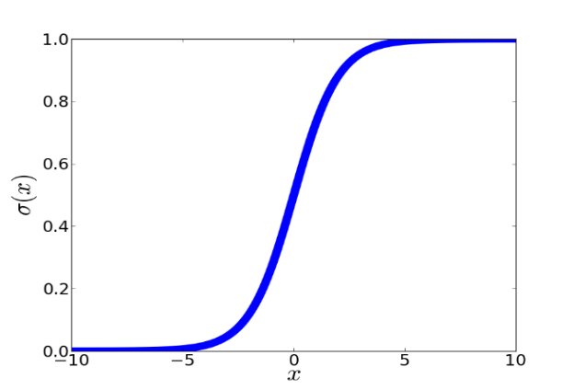
These Little Functions Are Chained Together
Deep learning comes from chaining a bunch of these little functions together
Chained together, they are called neurons
weight3 × input3
weight1 × input1
weight2 × input2

Slide 21

Deep Neural Network (DNN)

Slide 22
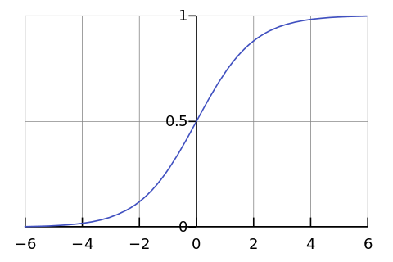
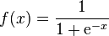
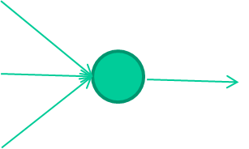
-0.06
W1
W2
f(x)
-2.5
W3
1.4

Slide 23
-0.06
2.7
-8.6
f(x)
-2.5
0.002
x = -0.06×2.7 + 2.5×8.6 + 1.4×0.002 = 21.34
1.4

Slide 24
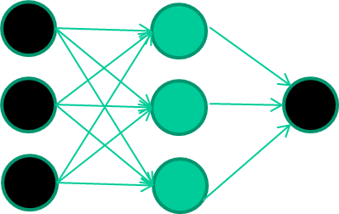
A dataset
Fields class
1.4 2.7 1.9 0
3.8 3.4 3.2 0
6.4 2.8 1.7 1
4.1 0.1 0.2 0
etc …

Slide 25
Training the neural network
Fields class
1.4 2.7 1.9 0
3.8 3.4 3.2 0
6.4 2.8 1.7 1
4.1 0.1 0.2 0
etc …

Slide 26
Training data
Fields class
1.4 2.7 1.9 0
3.8 3.4 3.2 0
6.4 2.8 1.7 1
4.1 0.1 0.2 0
etc …
Initialise with random weights

Slide 27
Training data
Fields class
1.4 2.7 1.9 0
3.8 3.4 3.2 0
6.4 2.8 1.7 1
4.1 0.1 0.2 0
etc …
Present a training pattern
1.4
2.7
1.9

Slide 28
Training data
Fields class
1.4 2.7 1.9 0
3.8 3.4 3.2 0
6.4 2.8 1.7 1
4.1 0.1 0.2 0
etc …
Feed it through to get output
1.4
2.7 0.8
1.9

Slide 29
Training data
Fields class
1.4 2.7 1.9 0
3.8 3.4 3.2 0
6.4 2.8 1.7 1
4.1 0.1 0.2 0
etc …
Compare with target output
1.4
2.7 0.8
0
1.9 error 0.8

Slide 30


Training data
Fields class
1.4 2.7 1.9 0
3.8 3.4 3.2 0
6.4 2.8 1.7 1
4.1 0.1 0.2 0
etc …
Adjust weights based on error
1.4
2.7 0.8
0
1.9 error 0.8

Slide 31
Training data
Fields class
1.4 2.7 1.9 0
3.8 3.4 3.2 0
6.4 2.8 1.7 1
4.1 0.1 0.2 0
etc …
Present a training pattern
6.4
2.8
1.7

Slide 32
Training data
Fields class
1.4 2.7 1.9 0
3.8 3.4 3.2 0
6.4 2.8 1.7 1
4.1 0.1 0.2 0
etc …
Feed it through to get output
6.4
2.8 0.9
1.7

Slide 33
Training data
Fields class
1.4 2.7 1.9 0
3.8 3.4 3.2 0
6.4 2.8 1.7 1
4.1 0.1 0.2 0
etc …
Compare with target output
6.4
2.8 0.9
1
1.7 error -0.1

Slide 34
Training data
Fields class
1.4 2.7 1.9 0
3.8 3.4 3.2 0
6.4 2.8 1.7 1
4.1 0.1 0.2 0
etc …
And so on ….
6.4
2.8 0.9
1
1.7 error -0.1
Repeat this thousands, maybe millions of times – each time
taking a random training instance, and making slight
weight adjustments
Algorithms for weight adjustment are designed to make
changes that will reduce the error

Slide 35
Training data
Fields class
1.4 2.7 1.9 0
3.8 3.4 3.2 0
6.4 2.8 1.7 1
4.1 0.1 0.2 0
etc …
Adjust weights based on error
6.4
2.8 0.9
1
1.7 error -0.1

Slide 36
The Decision Boundary Perspective…
Initial random weights

Slide 37
The Decision Boundary Perspective…
Present a training instance / adjust the weights

Slide 38
The Decision Boundary Perspective…
Present a training instance / adjust the weights

Slide 39
The Decision Boundary Perspective…
Present a training instance / adjust the weights

Slide 40
The Decision Boundary Perspective…
Present a training instance / adjust the weights

Slide 41
The Decision Boundary Perspective…
Eventually ….

Slide 42
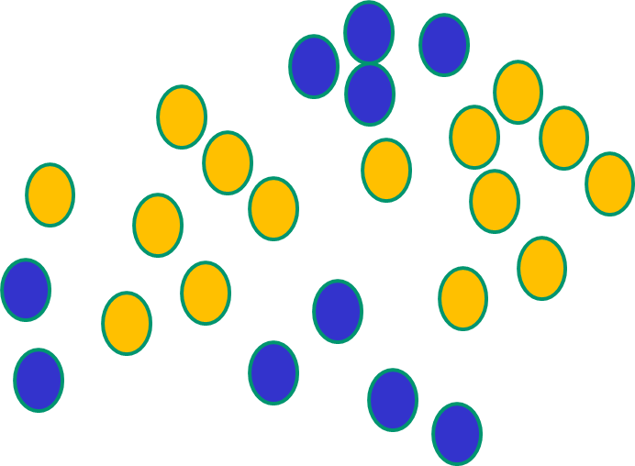
Some Other ‘By The Way’ Points
If f(x) is linear, the NN can only draw straight decision boundaries (even if there are many layers of units)

Slide 43
Some Other ‘By The Way’ Points
NNs use nonlinear f(x) so they
can draw complex boundaries,
but keep the data unchanged

Slide 44
Boundaries
NNs use nonlinear f(x) so they SVMs only draw straight lines,
can draw complex boundaries, but they transform the data first
but keep the data unchanged in a way that makes that OK

Slide 45
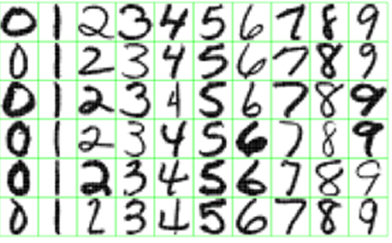
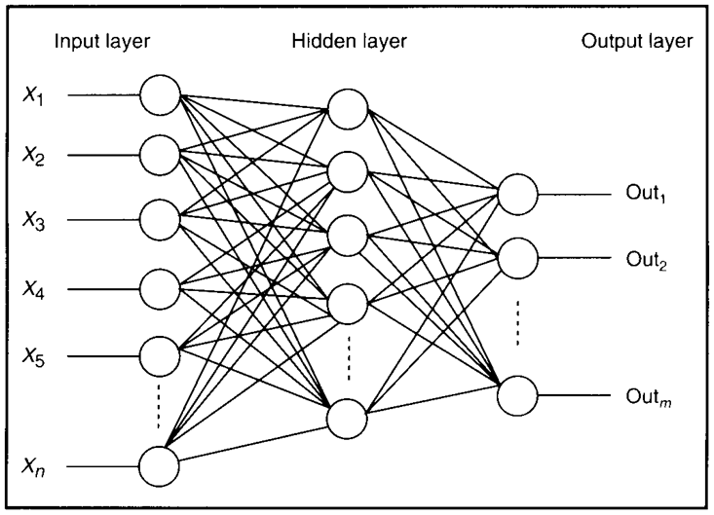
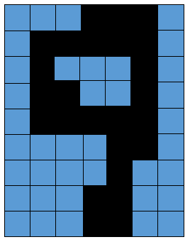
Feature Detectors

Slide 46
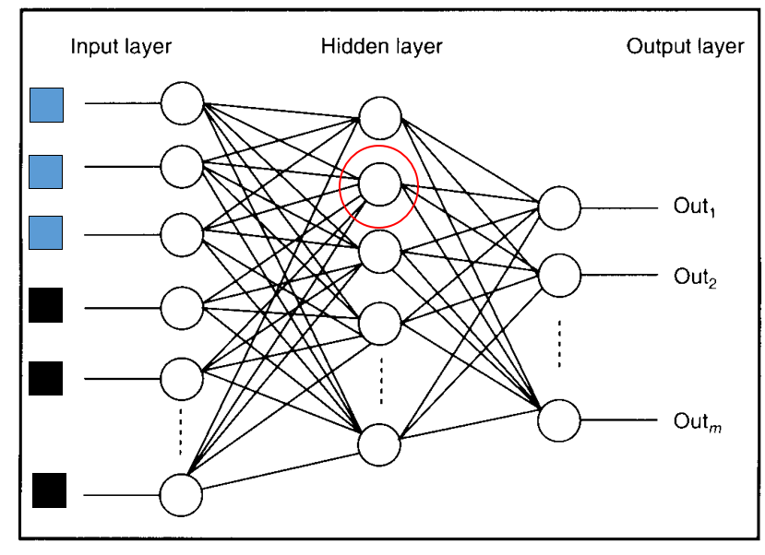
What Is This Unit Doing?

Slide 47
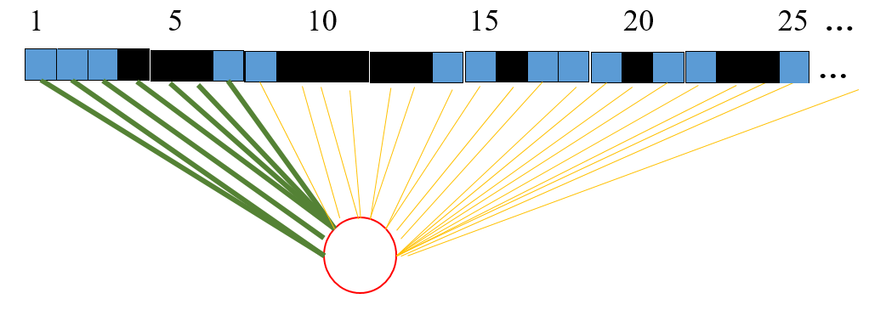
Hidden Layer Units Become Self-Organised Feature Detectors

Slide 48
What Does This Unit Detect?
strong +ve weight
low/zero weight
Strong signal for a horizontal line in the top row,
ignoring everywhere else

Slide 49
What features might you expect a good NN
to learn, when trained with data like this?

Slide 50
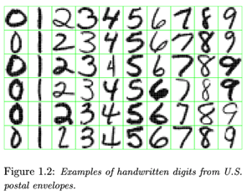
vertical lines

Slide 51
Horizontal lines
63

Slide 52
Small circles
63

Slide 53
Small circles
But what about position invariance ???
our example unit detectors were tied to
specific parts of the image
63

Slide 54
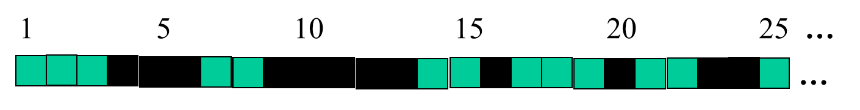
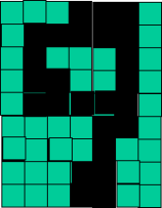
Successive Layers Can Learn Higher-Level Features
Detect lines in specific positions
etc …
Higher level detectors
( horizontal line,
“RHS vertical lune”
“upper loop”, etc…)
etc …
v

Slide 55
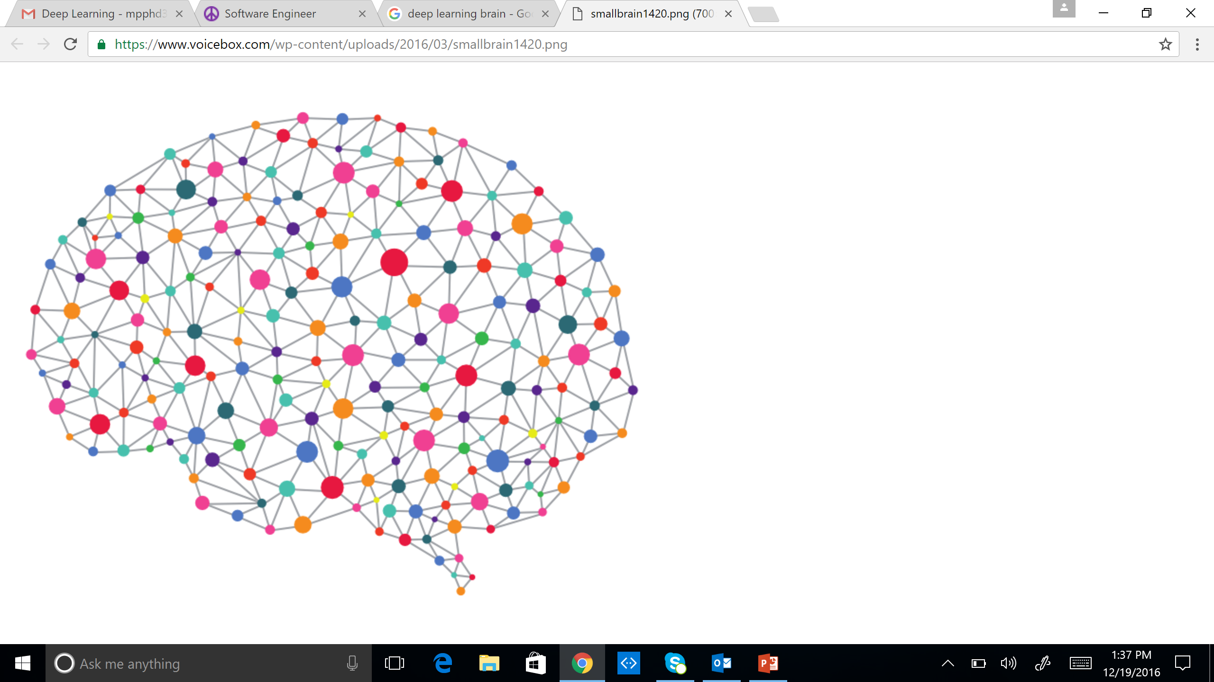
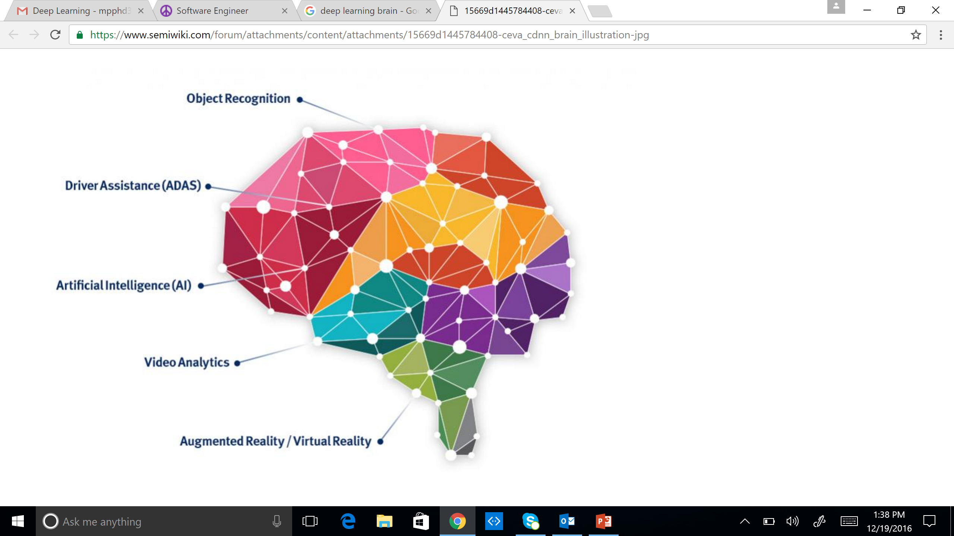
Multiple Layers Make Sense
Deep Learning = Brain “inspired”
Audio / Visual Cortex has multiple stages = Hierarchical

Slide 56
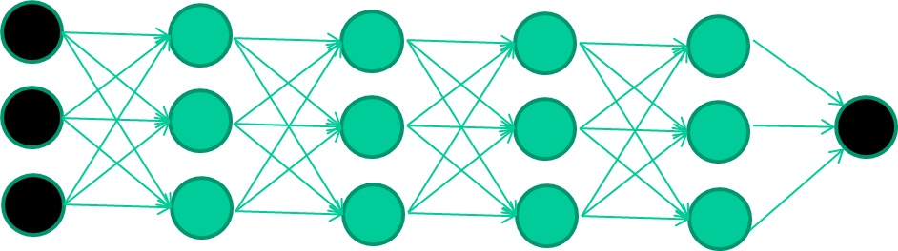
Multiple Layers Make Sense
Many-layer neural network architectures should be capable of learning the true underlying features and ‘feature logic’, and therefore generalise very well …

Slide 57
The New Way To Train Multi-Layer NNs…

Slide 58
The New Way To Train Multi-Layer NNs…
Train this layer first

Slide 59
The New Way To Train Multi-Layer NNs…
Train this layer first
then this layer

Slide 60
The New Way To Train Multi-Layer NNs…
Train this layer first
then this layer
then this layer

Slide 61
The New Way To Train Multi-Layer NNs…
Train this layer first
then this layer
then this layer
then this layer

Slide 62
The New Way To Train Multi-Layer NNs…
Train this layer first
then this layer
then this layer
then this layer
finally this layer

Slide 63
The New Way To Train Multi-Layer NNs…
Each layer can be thought of as a set of features

Slide 64
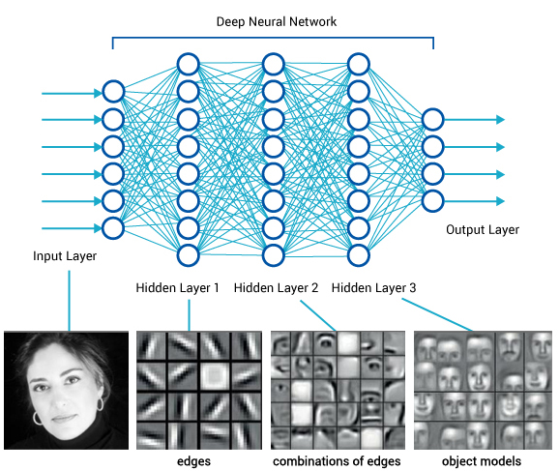
Idea Behind Deep Learning
There are many types of deep learning
Different kinds of autoencoder, variations on architectures and training algorithms, etc.
It’s a growing area

Slide 65
Common DNNs
Deep Convolutional Neural Network (DCNN)
To extract representation from images
Recurrent Neural Network (RNN)
To extract representation from sequential data
Deep Belief Neural Network (DBN)
To extract hierarchical representation from a dataset
Deep Reinforcement Learning (DQN)
To prescribe how agents should act in an environment in order to maximize future cumulative reward (e.g., a game score)
We will cover DCNN today

Slide 66
Deep Learning Frameworks

Slide 67
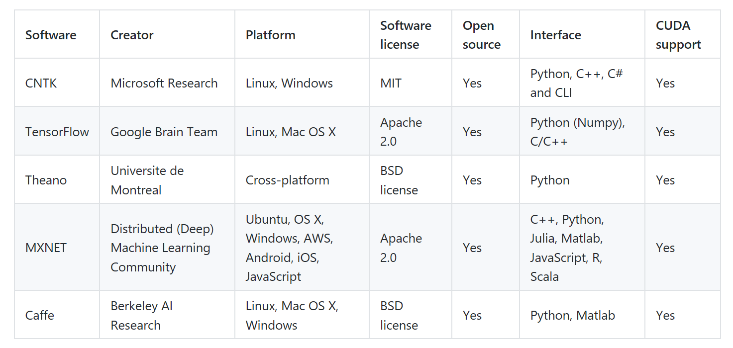
Open Source Deep Learning Frameworks

Slide 68
Symbolic vs Imperative Programs
Two fundamental programming models with Deep Learning toolkits: Symbolic and Imperative
Symbolic Programs
Functions are defined abstractly through computation graphs
First, express complex functions in terms of placeholder values
Execute these functions by binding them to real values
Many deep learning libraries are symbolic due to its efficiency - memory and runtime

Slide 69
Symbolic vs Imperative Programs
Symbolic Programs
Symbolic computation is useful for several reasons:
Because we define a full computation graph before executing it, sophisticated optimizations can be performed to eliminate unnecessary or repeated work. This tends to give better performance than imperative programming.
As the relationships between different variables are stored in the computation graph, we can then perform efficient auto-differentiation.

Slide 70
Symbolic vs Imperative Programs
Imperative Programs
Imperative style programs (Torch, Caffe, etc.) conduct the computation as we run them
More flexible than symbolic programs
More native than the symbolic ones
Easier to use native language features and inject them into computation flow

Slide 71
Deep Learning And Computer Vision

Slide 72
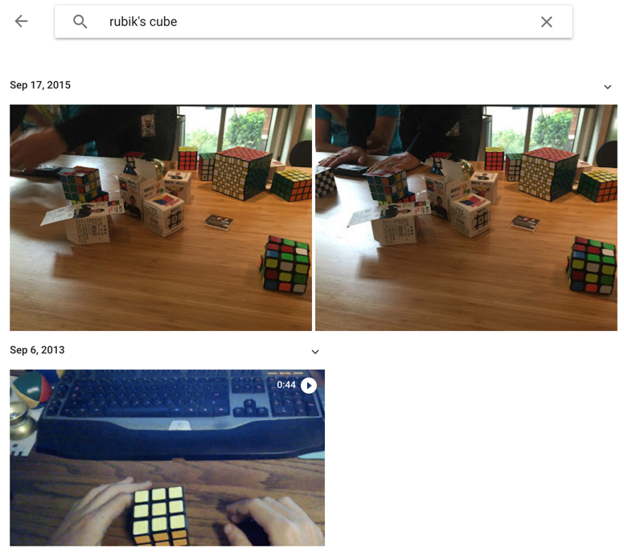
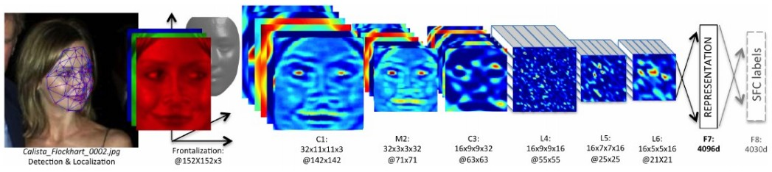
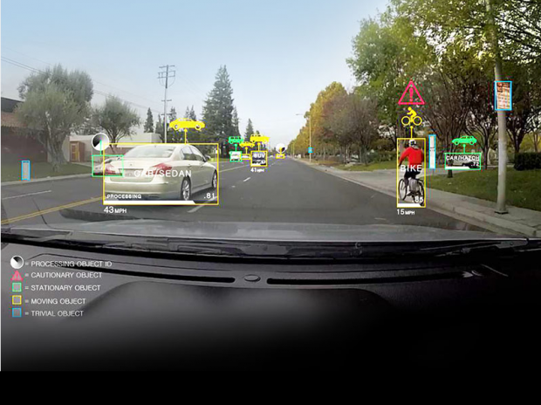
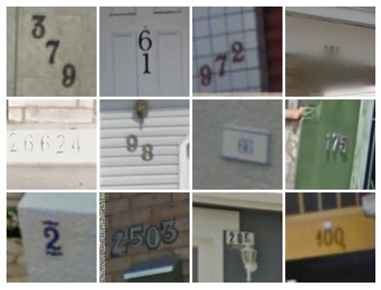
ConvNet
Face Verification, Taigman et al. 2014 (FAIR)
e.g. Google Photos search
[Goodfellow et al. 2014]
Self-driving cars

Slide 73
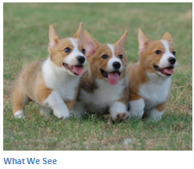
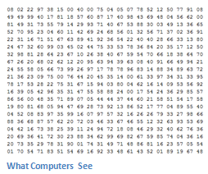
Image Classification
Task of taking an input image and outputting a class
Probability of classes that best describes the image
For humans, effortless task

Slide 74
Input Image
An image is an an array of pixel values
A JPG color image with size 480 x 480:
The representative array will be 480 x 480 x 3. Each number is given a value from 0 to 255 which is the pixel intensity
Grey scale image contains a single sample (intensity value) for each pixel
Image Classification:
Given an array of numbers, produce probabilities of the image being a certain class

Slide 75
Convolutional Neural Networks
Three basic ideas:
Local receptive fields
Shared weights
Pooling

Slide 76
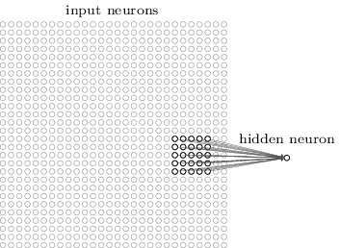
Local Receptive Fields
Connections are from small, localized regions of the input image to hidden layers
A little window on the input pixels
Each neuron in the first hidden layer is connected to a small region of the input neurons. For example, a 5x5 region

Slide 77
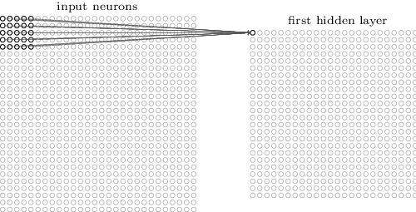
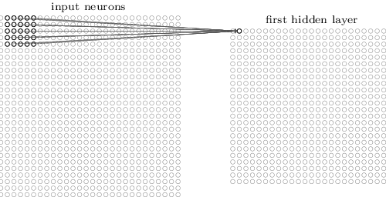
Local Receptive Fields

Slide 78
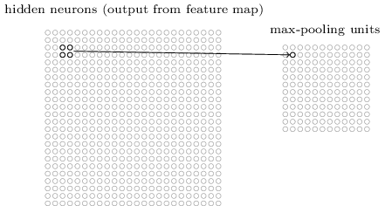
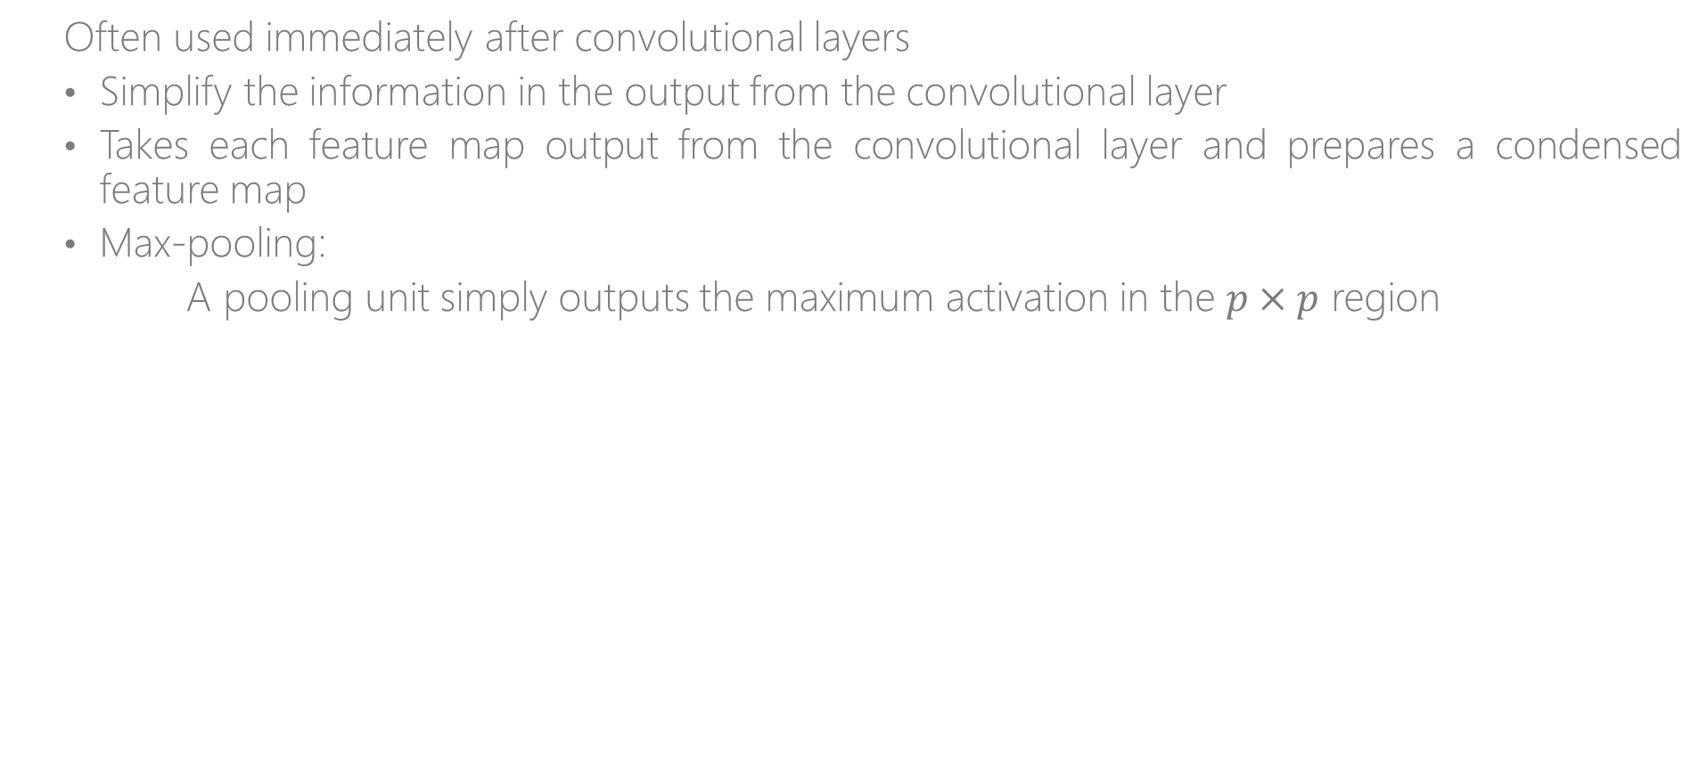
Pooling Layers
Often used immediately after convolutional layers
Simplify the information in the output from the convolutional layer
Takes each feature map output from the convolutional layer and prepares a condensed feature map
Max-pooling:
A pooling unit simply outputs the maximum activation in the $p×p$ region

Slide 79
Max Pooling
Single depth slice
1 | 1 | 2 | 4
5 | 6 | 7 | 8
3 | 2 | 1 | 0
1 | 2 | 3 | 4
x
max pool with 2x2 filters and stride 2
6 | 8
3 | 4
y

Slide 80

Pooling Layers
Smaller representations and more manageable
Operates over each activation map independently
Notes:
It is also referred to as a down sampling layer. In this category, there are also several layer options, with max pooling being the most popular. This basically takes a filter (normally of size 2x2) and a stride of the same length. It then applies it to the input volume and outputs the maximum number in every subregion that the filter convolves around.
As you can imagine, this layer drastically reduces the spatial dimension of the input volume. This serves two main purposes. The first is that the amount of parameters or weights is reduced by 75%, thus lessening the computation cost. The second is that it will control overfitting

Slide 81
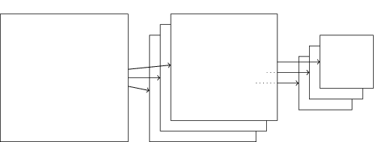
Pooling Layers
Combined convolutional and max-pooling layers:

Slide 82
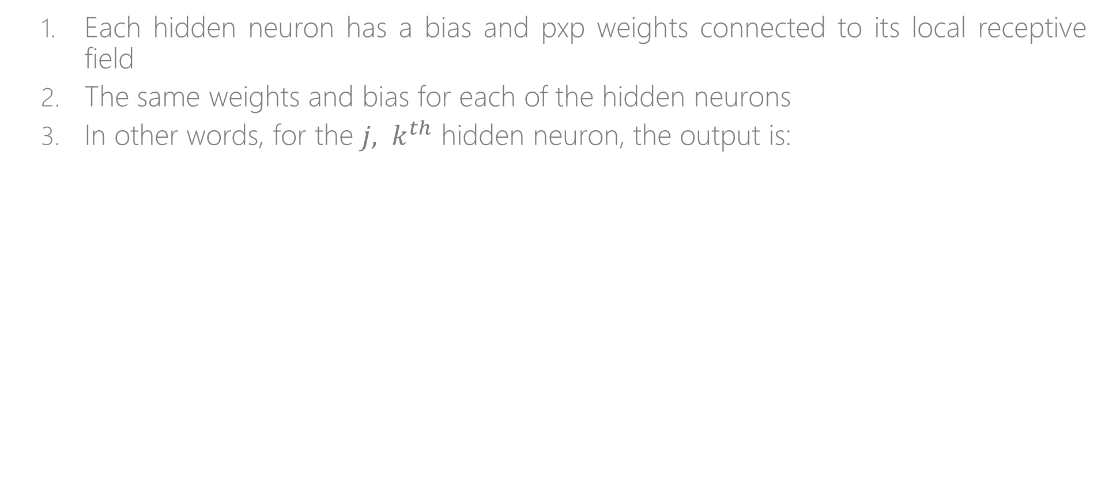
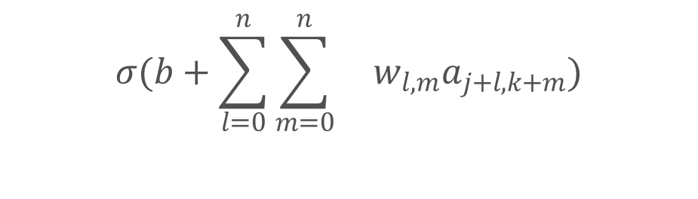
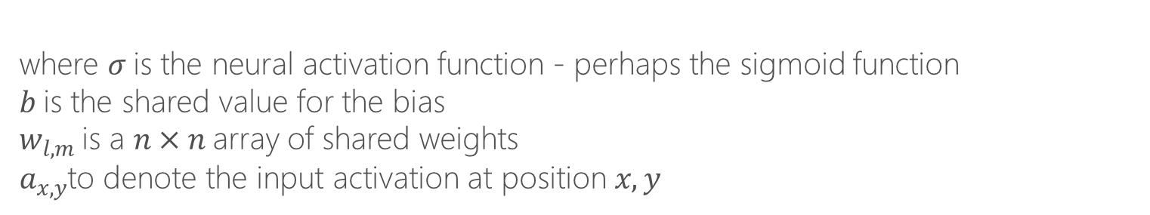
Shared Weights And Biases
Each hidden neuron has a bias and pxp weights connected to its local receptive field
The same weights and bias for each of the hidden neurons
In other words, for the ${j, k}^{th}$ hidden neuron, the output is:
$$σ(b+\sum_{l=0}^{n}{\sum_{m=0}^{n}{ w_{l,m}a_{j+l,k+m})}}$$
where $σ$is the neural activation function - perhaps the sigmoid function
$b$is the shared value for the bias
$w_{l,m}$is a $n×n$array of shared weights $a_{x,y}$to denote the input activation at position $x, y$

Slide 83
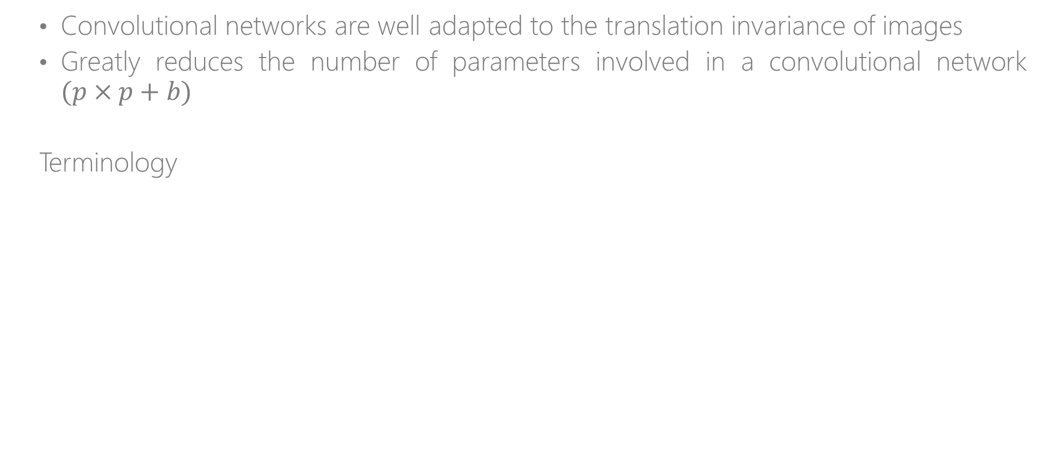
Shared Weights And Biases
Convolutional networks are well adapted to the translation invariance of images
Greatly reduces the number of parameters involved in a convolutional network $(p×p+b)$
Terminology
Feature map/Activation map | Map from the input layer to the hidden layer
Shared weights | Weights defining the feature map
Shared bias | Bias defining the feature map
Kernel/Filter | Shared weights and bias

Slide 84
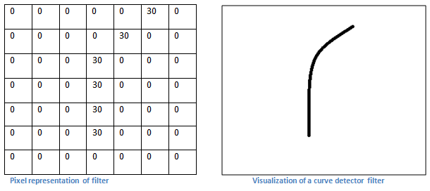
First Layer – High Level Perspective
Filters can be thought of as feature identifiers (straight edges, simple colors, and curves)
In the simple case of a one filter convolution and a curve detector filter, activation map results in regions that are most likely curves in the picture
More filters mean greater the depth of the activation map
This results in more information about the input

Slide 85
Going Deeper Through The Network
Many layers are interspersed between convolution layers (example: ReLu and Dropout)
Introduction of nonlinearities
Improve the robustness of the network and control overfitting

Slide 86
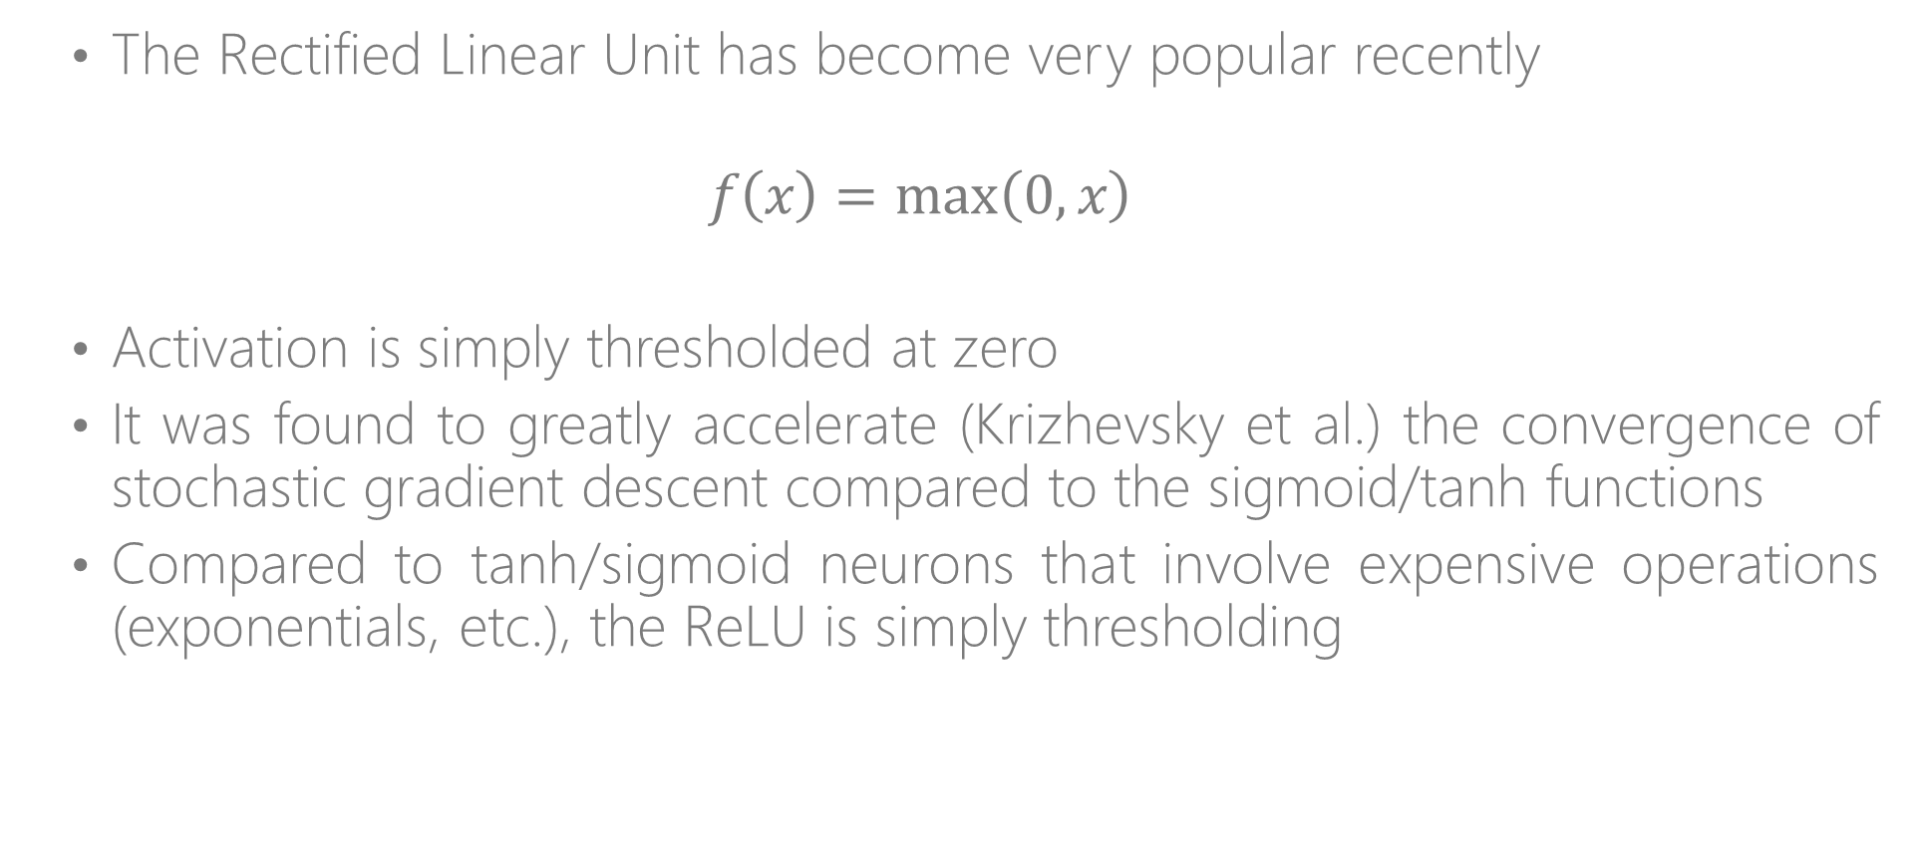
RelU
The Rectified Linear Unit has become very popular recently
$$f\left(x\right)=\max\left(0,x\right)$$
Activation is simply thresholded at zero
It was found to greatly accelerate (Krizhevsky et al.) the convergence of stochastic gradient descent compared to the sigmoid/tanh functions
Compared to tanh/sigmoid neurons that involve expensive operations (exponentials, etc.), the ReLU is simply thresholding

Slide 87
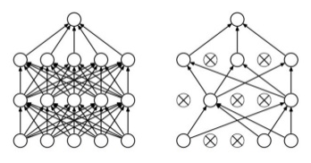
Dropout
A form of ensemble learning
Avoids overfitting (by preventing inter-dependencies from emerging between nodes)
Dropout - an extreme version of bagging
At each training step, the dropout procedure creates a different network by removing some neurons randomly

Slide 88

Fully Connected Layer (FC layer)
Notes:
Contains neurons that connect to the entire input volume, as in ordinary Neural Networks

